Slide 1
Introduction to Burp Suite
Web Vulnerability Scanning and Basic Penetration Testing
Created By Jack Kelly

Slide 2

Agenda
Sign in
Announcements
Sign in (with phrase of the day)
Burp Suite Overview
Burp Suite Key Features
Burp Suite Tools
Follow-Along Demos
Information Disclosure
Cross-Site Scripting
Cross-Site Request Forgery
SQL Injection
???
Profit
Phrase of the day is “JasonIsMidAtPickleball”

Slide 3

What is Burp Suite?
Burp Suite is a leading web vulnerability scanner and penetration testing tool.
Developed by PortSwigger, it is widely used for assessing the security of web applications.

Slide 4
Burp Suite: Key Features
Proxy: Intercept and modify HTTP requests.
Intruder: Perform automated attacks on web applications.
Repeater: Manually manipulate and resend requests.
Decoder: Decode and encode data.
Scanner*: Automated vulnerability scanning.
Collaborator*: Identify and test for server-side vulnerabilities.
Supports Extensions to expand on capabilities
* Burp Suite Professional Only

Slide 5
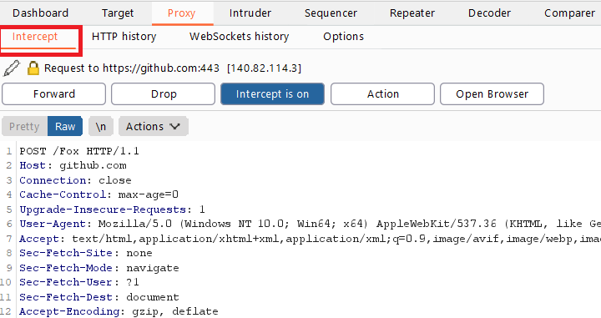
Burp Suite: Proxy Tool
Acts as an intermediary between the client and server.
Allows you to intercept, inspect, and modify HTTP requests and responses.
Useful for understanding how a web application works and identifying potential security issues.

Slide 6
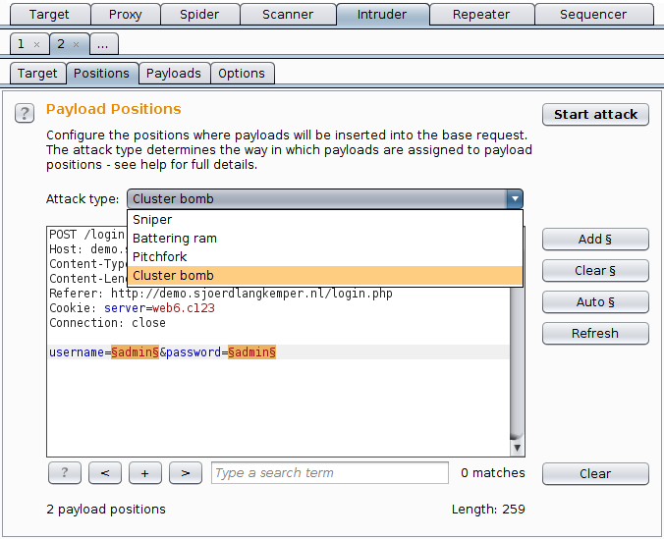
Burp Suite: Intruder Tool
Automates various types of attacks on web applications.
Helps test for vulnerabilities like brute force, time-based attacks, and more.
Useful for discovering and exploiting vulnerabilities.

Slide 7
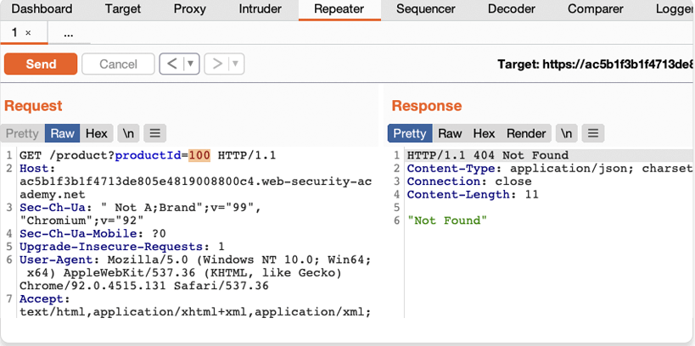
Burp Suite: Repeater Tool
Manually manipulate and repeat HTTP requests.
Enables you to test how the application responds to various inputs.
Valuable for fine-tuning and verifying vulnerabilities.

Slide 8
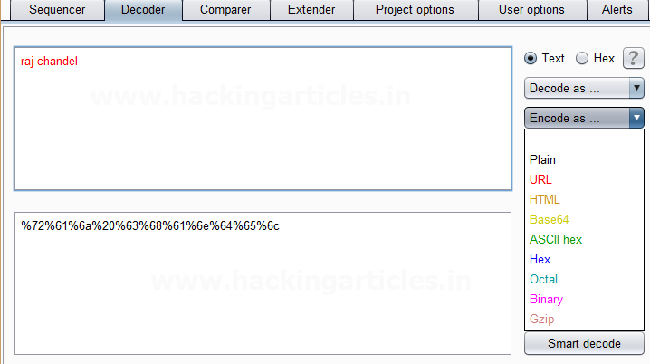
Burp Suite: Decoder Tool
Decodes and encodes data in various formats (Base64, URL encoding, etc.)
Useful for analyzing and modifying data on the fly during testing.

Slide 9
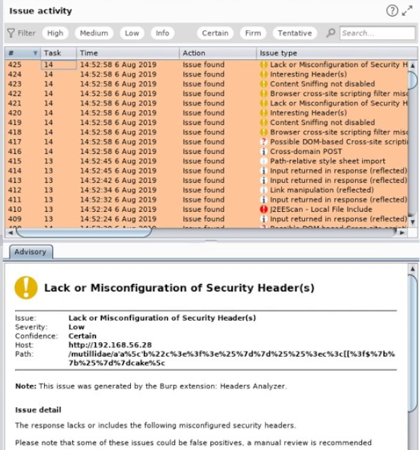
Burp Suite: Scanner Tool*
Automated vulnerability scanner for web applications.
Identifies common security issues such as SQL injection, XSS, and more.
Provides detailed reports with vulnerability information.
* Burp Suite Professional Only

Slide 10
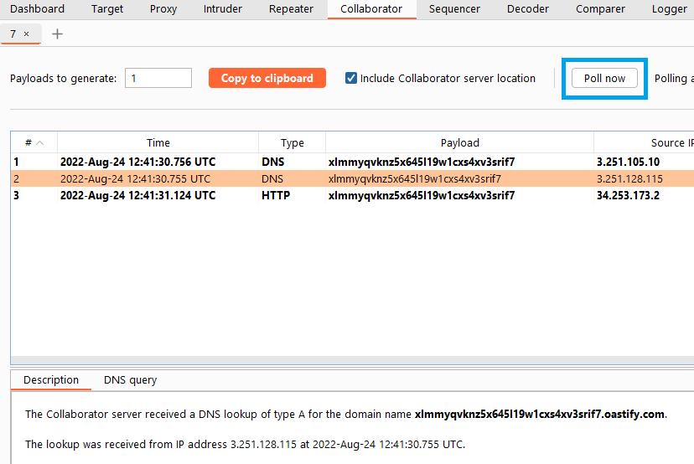
Burp Suite: Collaborator Tool*
Detects server-side issues and interactions with external services.
Helps identify issues like SSRF and DNS interactions.
Aids in identifying blind vulnerabilities
Complex
* Burp Suite Professional Only

Slide 11
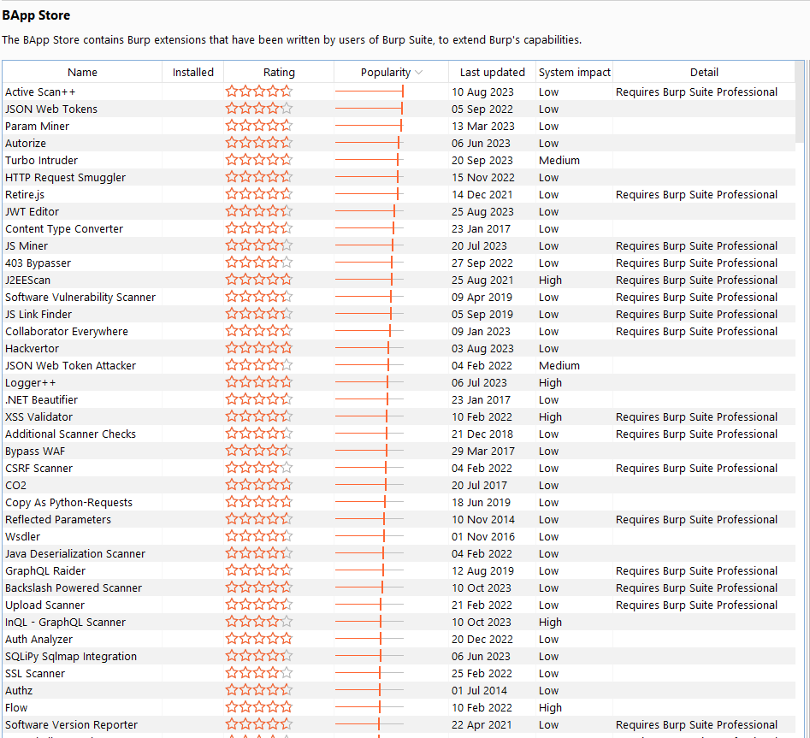
Burp Suite: Extensions
Extensions are add-ons or plugins that can be integrated into Burp Suite to extend its features.
They are typically written in Java and allow for customizing various aspects of the tool.

Slide 12
Burp Suite: Extensions
Burp Suite supports several types of extensions, including:
BApp (Burp Application) Extensions: These extensions add new features and functionalities to Burp Suite.
BEng (Burp Engine) Extensions: These modify the behavior of existing features.
BScanner (Burp Scanner) Extensions: These enhance the capabilities of the Burp Scanner tool.
BPassive (Burp Passive) Extensions: These monitor and analyze passive scan issues.
Some popular extensions include:
Autorize: Helps automate authorization testing.
Backslash Powered Scanner: Enhances scanning for server-side request forgery (SSRF) vulnerabilities.
J2EEScan: Specialized for Java-based applications.
HUNT Suite: Adds unique, innovative scanning capabilities.
Collaborator Everywhere: Expands the functionality of Burp Collaborator.

Slide 13
Burp Suite: Use Cases
Web application security testing
Vulnerability assessment
Penetration testing
Bug bounty programs
Learning and understanding web security

Slide 14
Burp Suite: Benefits
Comprehensive and user-friendly interface
Regular updates and community support
Suitable for both beginners and advanced security professionals
Versatile and adaptable for a wide range of testing scenarios

Slide 15
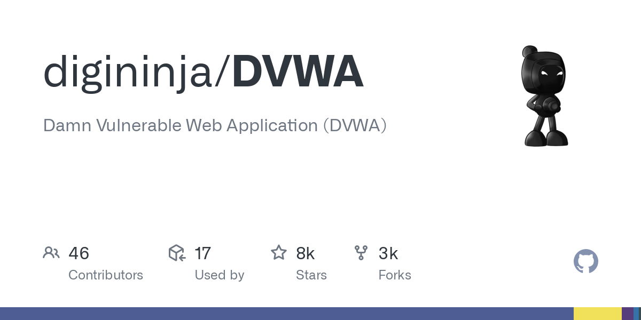
Resources
https://portswigger.net/web-security
https://portswigger.net/web-security/learning-paths/server-side-vulnerabilities-apprentice
https://portswigger.net/burp/documentation/desktop/getting-started
https://trustedsec.com/blog/intro-to-web-app-security-testing-burp-suite-tips-tricks
Damn Vulnerable Web Application (DVWA)
Damn Vulnerable Web Application (DVWA) is a PHP/MySQL web application that is damn vulnerable. Its main goal is to be an aid for security professionals to test their skills and tools in a legal environment, help web developers better understand the processes of securing web applications and to aid both students & teachers to learn about web application security in a controlled classroom environment.
github.com/digininja/DVWA

Slide 16
Pause
Questions?
Next: Burp Suite Demos

Slide 17
Burp Demo: Information Disclosure
What is an information disclosure vulnerability?
PortSwigger Lab
Information Disclosure in Error Messages
Information disclosures occur when private information about your assets, applications, or users is divulged or accessible to unauthorized entities.
This information may be used to further target your system.
Notes:
With Burp running, open one of the product pages.
In Burp, go to "Proxy" > "HTTP history" and notice that the GET request for product pages contains a productID parameter. Send the GET /product?productId=1 request to Burp Repeater. Note that your productId might be different depending on which product page you loaded.
In Burp Repeater, change the value of the productId parameter to a non-integer data type, such as a string. Send the request:
GET /product?productId="example"
The unexpected data type causes an exception, and a full stack trace is displayed in the response. This reveals that the lab is using Apache Struts 2 2.3.31.
Go back to the lab, click "Submit solution", and enter 2 2.3.31 to solve the lab.
With Burp running, open one of the product pages.
In Burp, go to "Proxy" > "HTTP history" and notice that the GET request for product pages contains a productID parameter. Send the GET /product?productId=1 request to Burp Repeater. Note that your productId might be different depending on which product page you loaded.
In Burp Repeater, change the value of the productId parameter to a non-integer data type, such as a string. Send the request:
GET /product?productId="example"
The unexpected data type causes an exception, and a full stack trace is displayed in the response. This reveals that the lab is using Apache Struts 2 2.3.31.
Go back to the lab, click "Submit solution", and enter 2 2.3.31 to solve the lab.

Slide 18
Burp Demo: Cross-Site Scripting (XSS)
What is an XSS vulnerability?
PortSwigger Lab
Reflected XSS in Search Function
XSS occurs when an application includes untrusted data from a user (usually via a web page) in the web page content that is then sent to a user's browser.
This untrusted data is treated as code and executed by the user's browser.
XSS vulnerabilities allow attackers to inject malicious scripts into web pages viewed by other users.
Notes:
Copy and paste the following into the search box: <script>alert(1)</script>
Click "Search".

Slide 19
Burp Demo: Cross-Site Request Forgery (CSRF)
What is a CSRF vulnerability?
PortSwigger Lab
CSRF (No Defense)
CSRF occurs when an attacker tricks a user into unknowingly making unwanted and unauthorized actions on a different website while authenticated on a target website.
Authentication: The victim user is logged into a trusted website (e.g., their online banking or email account) and has a session with the website.
Malicious Request: The attacker creates a malicious web page or email with a hidden form or script that sends a request to the target website on behalf of the victim.
Unintentional Action: When the victim visits the attacker's page, their browser automatically sends the malicious request to the target website, without the user's knowledge.
Notes:
Open Burp's browser and log in to your account. Submit the "Update email" form, and find the resulting request in your Proxy history.
If you're using Burp Suite Professional, right-click on the request and select Engagement tools / Generate CSRF PoC. Enable the option to include an auto-submit script and click "Regenerate". Alternatively, if you're using Burp Suite Community Edition, use the following HTML template. You can get the request URL by right-clicking and selecting "Copy URL". <form method="POST" action="https://YOUR-LAB-ID.web-security-academy.net/my-account/change-email"> <input type="hidden" name="email" value="anything%40web-security-academy.net"> </form> <script> document.forms[0].submit(); </script>
Go to the exploit server, paste your exploit HTML into the "Body" section, and click "Store".
To verify that the exploit works, try it on yourself by clicking "View exploit" and then check the resulting HTTP request and response.
Change the email address in your exploit so that it doesn't match your own.
Click "Deliver to victim" to solve the lab.

Slide 20
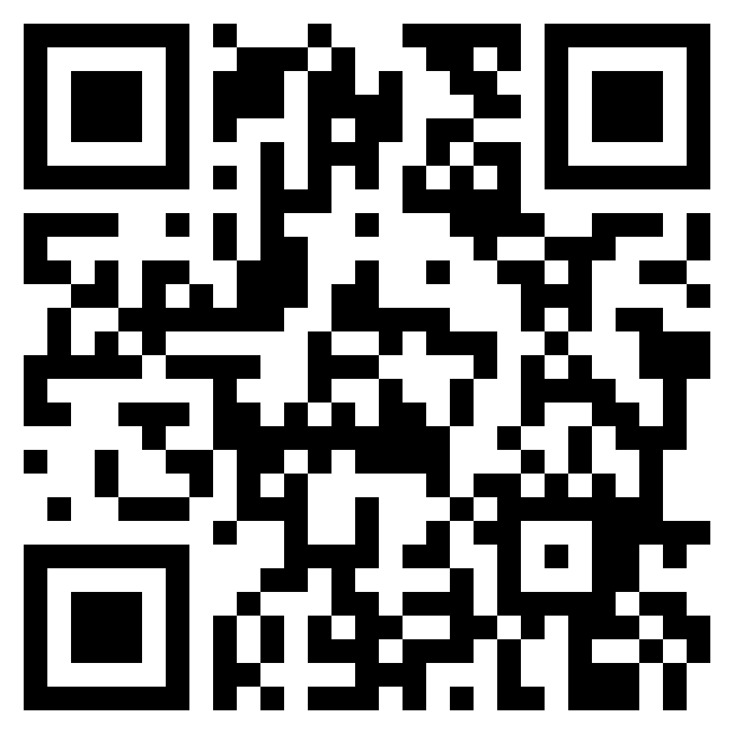
Burp Demo: Cross-Site Request Forgery (CSRF)
CSRF Demo on Youtube
Notes:
Open Burp's browser and log in to your account. Submit the "Update email" form, and find the resulting request in your Proxy history.
If you're using Burp Suite Professional, right-click on the request and select Engagement tools / Generate CSRF PoC. Enable the option to include an auto-submit script and click "Regenerate". Alternatively, if you're using Burp Suite Community Edition, use the following HTML template. You can get the request URL by right-clicking and selecting "Copy URL". <form method="POST" action="https://YOUR-LAB-ID.web-security-academy.net/my-account/change-email"> <input type="hidden" name="email" value="anything%40web-security-academy.net"> </form> <script> document.forms[0].submit(); </script>
Go to the exploit server, paste your exploit HTML into the "Body" section, and click "Store".
To verify that the exploit works, try it on yourself by clicking "View exploit" and then check the resulting HTTP request and response.
Change the email address in your exploit so that it doesn't match your own.
Click "Deliver to victim" to solve the lab.

Slide 21
Burp Demo: SQL Injection
What is a SQL Injection vulnerability?
PortSwigger Lab
SQL Injection (Login Bypass)
Occurs when an attacker is able to manipulate or inject malicious SQL (Structured Query Language) code into an application's input fields.
This code is then executed by the application's database, allowing the attacker to view, modify, or delete data from the database.
SQL Injection vulnerabilities are particularly dangerous because they can lead to unauthorized access to sensitive information and potentially even the complete compromise of a web application.
Notes:
Use Burp Suite to intercept and modify the login request.
Modify the username parameter, giving it the value: [administrator'--]

Slide 22
$ AWS Cloud Security Consultant
Roles & Recruitment
$ c2 Development
(Maldev)
Wednesday:
Questions?
Event Starts @ 5pm
Friday:

